Slide 1

Honey Link Beta Presentation
Darien Mulet-Soltren/Nathalia McMillan/Samantha Piper

Slide 2

Introduction & Problem
Team Members
Audience and Goals
In today’s society many struggle to make connections in real life due to the rise in social media, but what if instead it was used to promote in-person connections?
Honey-Link is an app directed towards those aged between 16-40 years of age. It encourages users to out and link up with those they share similarities with.
Whether you're an introvert, busy college student, or simply looking to grow your friend group this app is just for you!
Darien: Design Lead
Nathalia: Usability Tester
Samantha: Prototype Developer

Slide 3
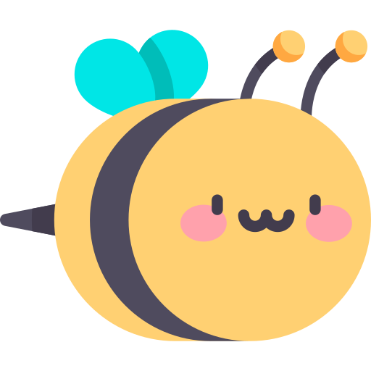
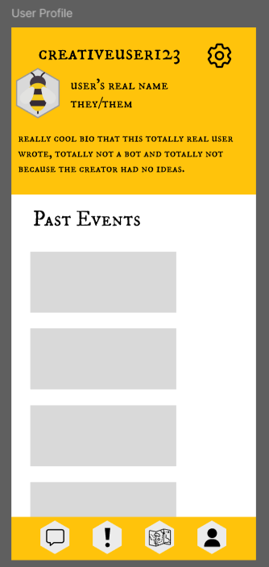
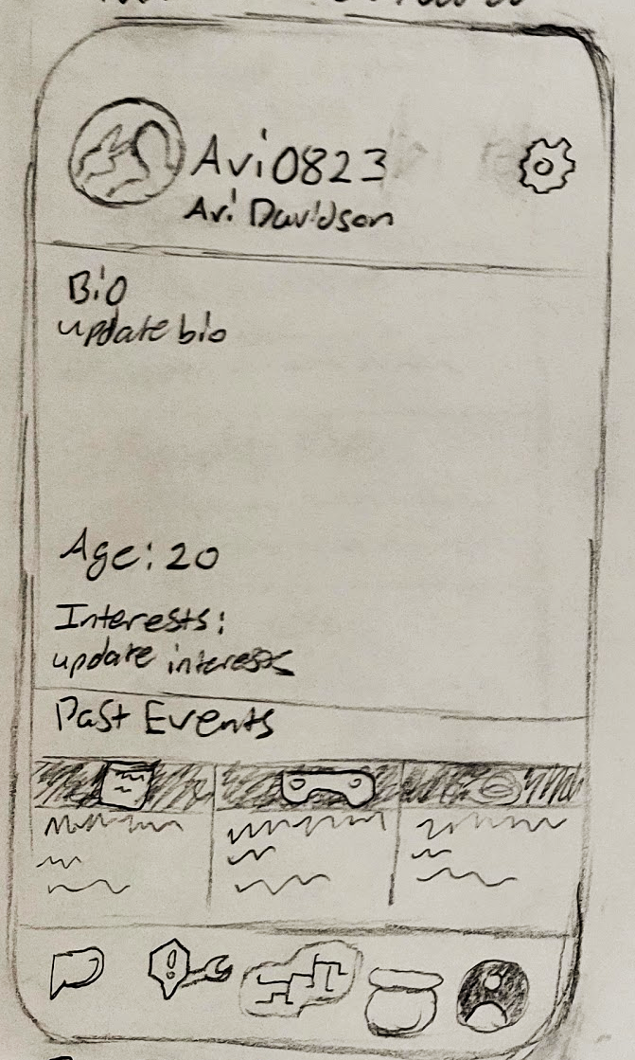
Research & Design Evolution User Profile
The original product proposal bring up a customizable user profile with special features tied to it.
The Lofi attempting to stay loyal to this format while the hifi branches out more. It rearranged already established icons for more versatility.
Lofi
Hifi

Slide 4
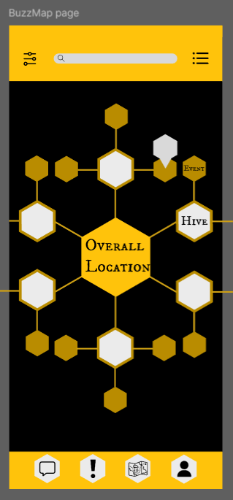
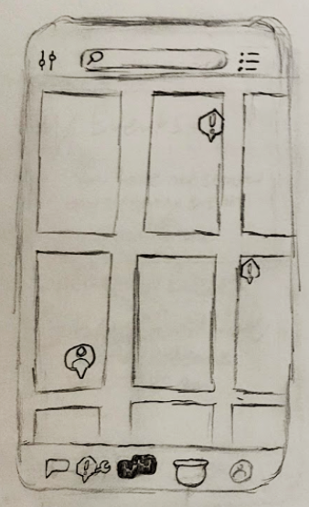
Research & Design Evolution Cont
In the original product proposal under the product description a BuzzMap feature is introduced where friends from the same hub can meet up and plan events.
In the Lofi version, the locations were displayed in the shapes of rectangles.
After some feedback, it was changed to a pentagon to suit the bee aesthetic better.
Lofi
Hifi

Slide 5
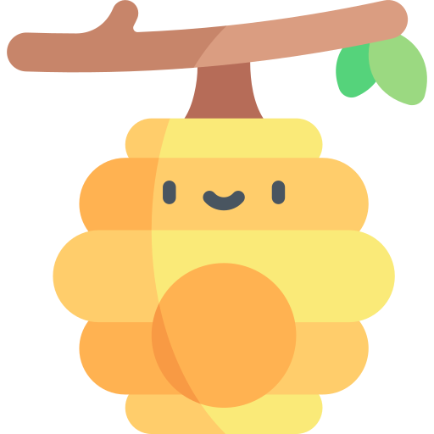
Live Demo⭐
Figma Link

Slide 6

Conclusion
This project caused us as a group to think more deeply about social media and how it appeals to people. Through user feedback we also learned to prioritize the comfortability of a given audience and how they perceive their interactions with this app.
Unlike other social media platforms, this app encourages people to go outside and seek out real life connections. Imagine if meeting all your closest online friends was as easy as pressing a button.
Any Questions?

